Slide 1

uantum
Society
at Auburn

Slide 2

VP of Outreach Applications!
AU Involve!
Search “Quantum Society at Auburn” On AU Involve and join!
New Website!
https://quantum-society-at-auburn.github.io/website/

Slide 3
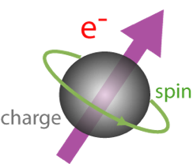
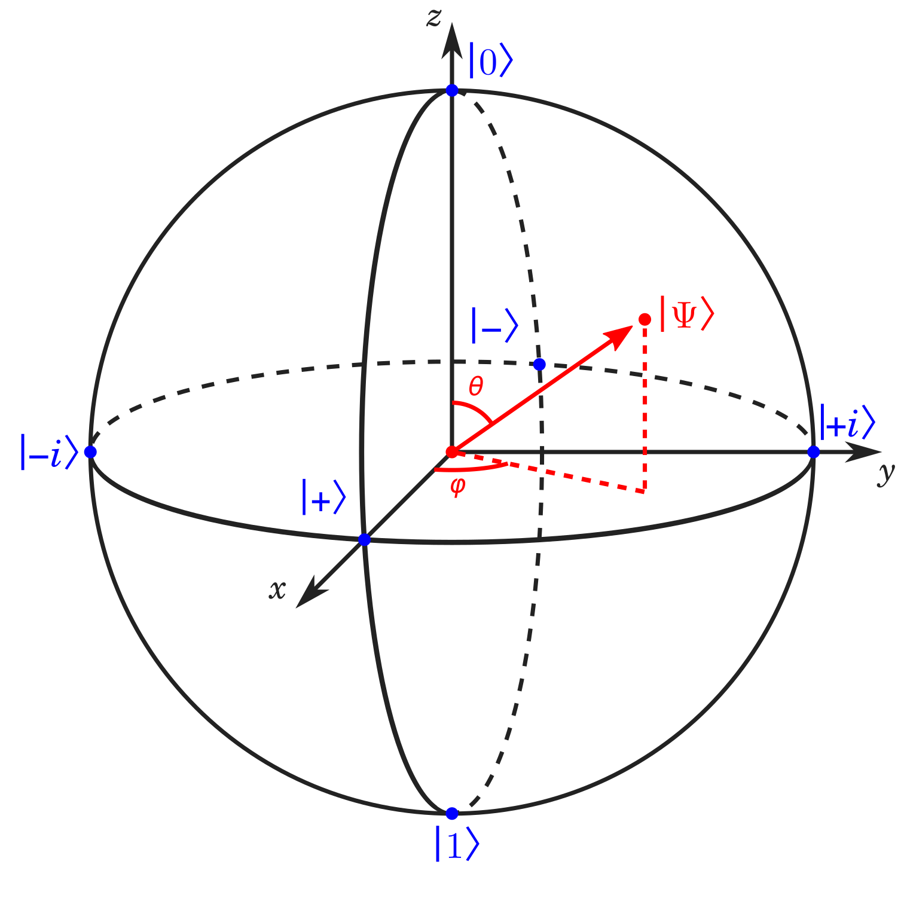
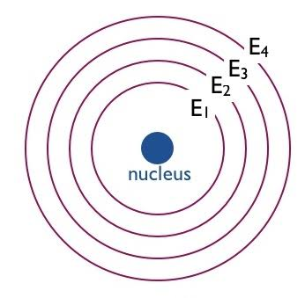
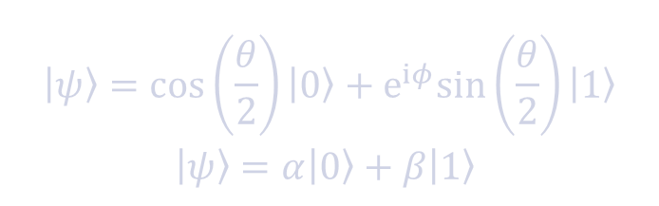

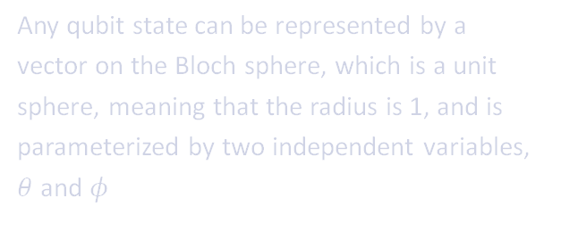

Qubit Review and Bloch Sphere
Any qubit state can be represented by a vector on the Bloch sphere, which is a unit sphere, meaning that the radius is 1, and is parameterized by two independent variables, $θ$ and $φ$
$$\left|ψ\right\rangle =\cos\left(\frac{θ}{2}\right)\left|0\right\rangle +e^{iφ}sin\left(\frac{θ}{2}\right)\left|1\right\rangle$$
$$\left|ψ\right\rangle =α\left|0\right\rangle +β\left|1\right\rangle$$
$$|01⟩$$
$$|01⟩$$

Slide 4



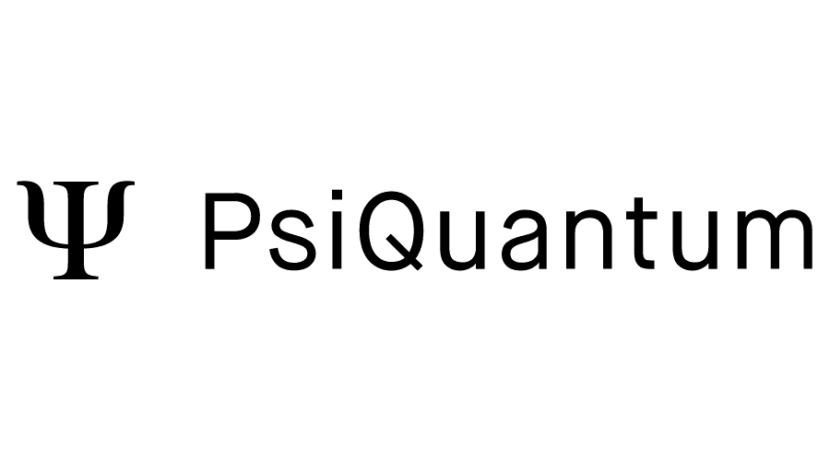







Realizations of Quantum Computing
Superconducting
Neutral Atoms
Trapped Ions
Photonic
$$|01⟩$$
$$|02⟩$$

Slide 5
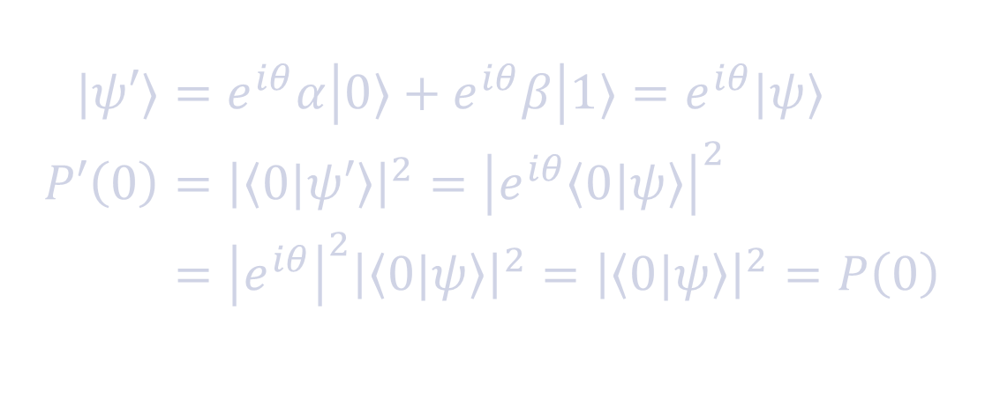

Global vs Relative Phase
When you apply rotations to a qubit, you can add a phase depending on the gate chosen.
Applying a phase to all states, or a global phase, is the same as doing nothing. This leaves the probabilities unchanged
Applying the phase to a single state, or a relative phase, is invisible to a single measurement, but can combine with other operations to cancel out and add together
$$\begin{aligned}|ψ′⟩&=e^{iθ}α\left|0⟩+e^{iθ}β\right|1⟩=e^{iθ}|ψ⟩ \\ P′\left(0\right)&={\left|\left\langle 0|ψ′\right\rangle \right|}^{2}={\left|e^{iθ}\left\langle 0|ψ\right\rangle \right|}^{2} \\ &={\left|e^{iθ}\right|}^{2}{\left|\left\langle 0|ψ\right\rangle \right|}^{2}={\left|\left\langle 0|ψ\right\rangle \right|}^{2}=P\left(0\right)\end{aligned}$$
$$|01⟩$$
$$|03⟩$$

Slide 6

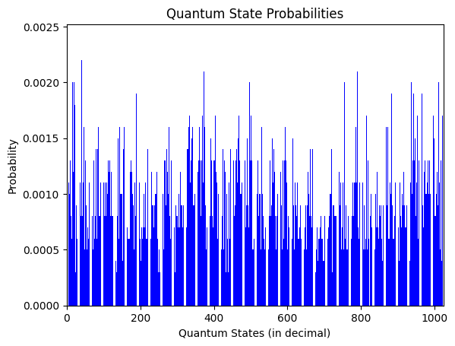

Interference: How Quantum Computing actually works
Quantum computing prepares states with amplitudes
While superposition and entanglement allow us to perform lots of parallel computation that classical does not, when we measure a quantum state, we still only get one probability output back. So most information is lost.
$$|01⟩$$
$$|04⟩$$

Slide 7
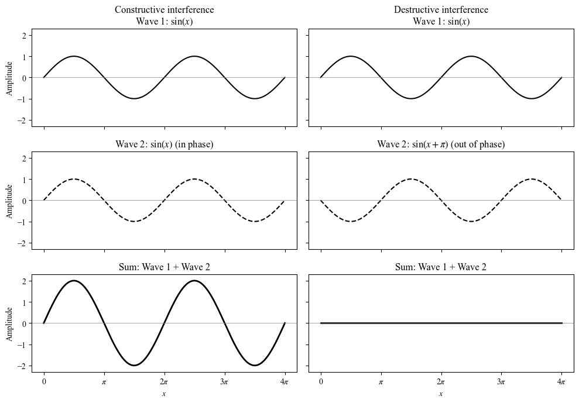

Interference: How Quantum Computing actually works
To combat this, we have to use the concept of interference and waves.
Using relative phases, we imagine different states as waves with phases and amplitudes, and we combine them in such a way that we can cancel out wrong answers and add correct ones.
$$|01⟩$$
$$|05⟩$$

